Slide 1


An estimation and novel design of future predictive model for solar cell parameters using AI/ ML
Mini Project Final Evaluation Presentation
GROUP- 24
Members: Prince Patel (19BIT101)
Nishan Patel (19BIT091)
Shailesh Vekariya (19BIT114)
Vrund Chaudhari (19BIT132)
Himanshi Panchal (19BIT137)
Department of
Information and Communication Technology
Under the Supervision and Guidance of Dr. Deepak Jarwal Assistant Professor - EC Pandit Deendayal Energy University

Slide 2
Overview
Introduction
Factors affecting efficiency
Algorithms
Methodology
Result
Future Work

Slide 3
Introduction
The buzz word in renewable energy sector is Solar enrgy.
Park, solar farm, or solar power plant, is a large-scale grid-connected photovoltaic power system (PV system) designed for the supply of merchant power.
There are various environmental parameters affects the solar energy generation.
major issue : to estimate or forecast energy generated by farm in future.
One sun One Grid (International Solar Alliance).

Slide 4
To use conventional and renewable energy together, prediction of power generation by solar cell is important
Three type of forecasting: short term, middle term, long term
Short term: in minutes
Middle term: in hours
Long term: in days
In this project we are working to make a model that can forecast the energy generation by solar panel on next day.

Slide 5
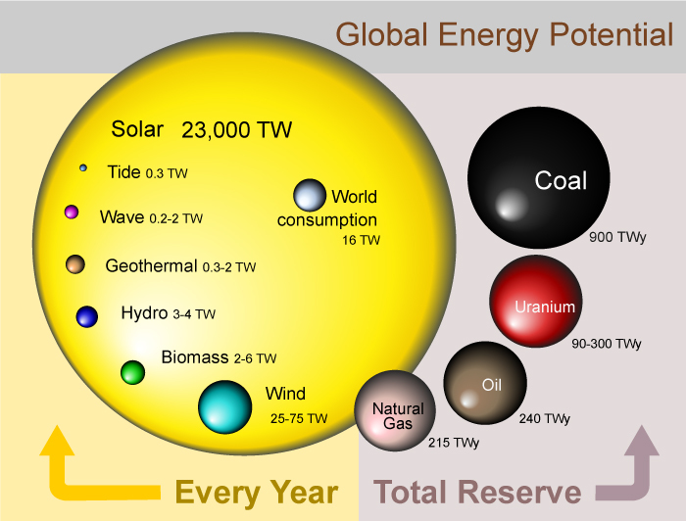
https://www.isolarworld.com/blog/solar-grid-tied-off-grid-system-and-hybrid-solar-systems/

Slide 6
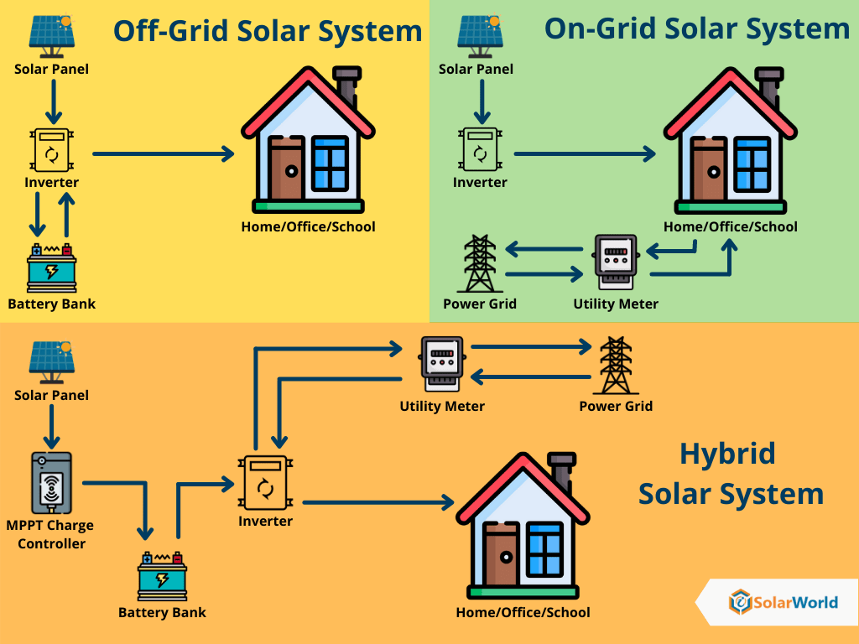
Why Solar Energy?
https://commons.wikimedia.org/wiki/File:Global

Slide 7
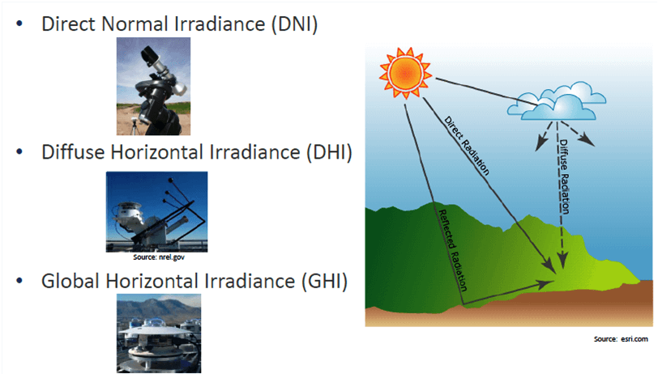
The Factors that affect the efficiency of solar panel:-
Solar Irradiance
Solar irradiance is the power per unit area received from the Sun in the form of electromagnetic radiation. Solar irradiance is measured in watts per square metre (W/m2) in SI units.
It is strongly correlated to PV power generation.
https://www.yellowhaze.in/solar-irradiance/

Slide 8
Temperature
Efficiency varies according to temperature changes
Higher temperatures have a negative impact on efficiency
efficiency decreases as temperature
Temperature increases resistance increases
Humidity
Forms thin layer of water
lowers efficiency by 10–20% of the overall power generated

Slide 9
UV Rays
Under long-term exposure to UV light, adverse affects can happen due to generation of surface defects.
UV radiation have largely been associated with the aging of module packaging materials and have led to encapsulant discoloration, delamination, and backsheet cracking.
Within a silicon solar cell, the UV light can cause damage to the passivation layers, to the silicon beneath, and at the interface between the two cells.

Slide 10
Algorithms
Linear Regression
Light Gradient Boosting Machine
Stack Model

Slide 11
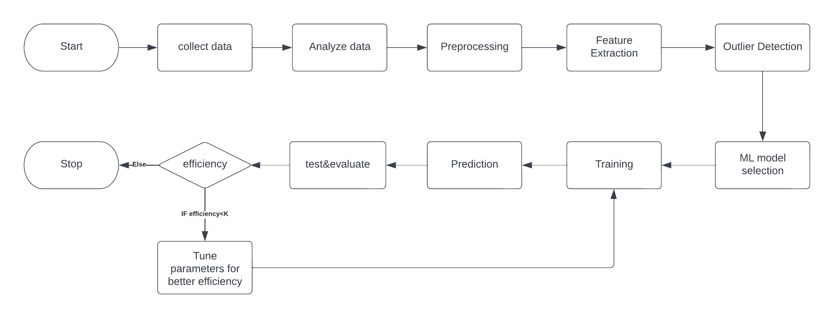
Flowchart

Slide 12
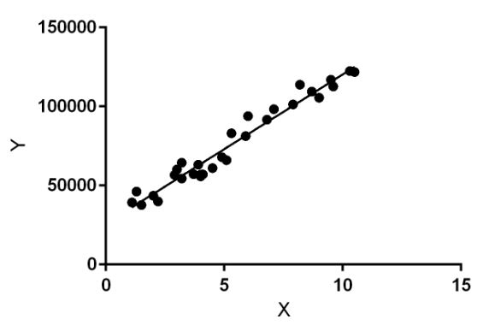
Methodology
Linear Regression:
Supervised Learning
commonly used for predictive analysis.
Gives relationship between two continuous variable
Library used:Pandas, Numpy, Matplotlib, Seaborn, Scikitlearn
Tools Required:Jupyter Notebook

Slide 13
Why Linear Regression?
Relatively simple and provide an easy-to-interpret mathematical formula that can generate predictions.
Predict the value of a variable based on the value of another variable.
Long-established statistical procedure
Trained very quickly

Slide 14
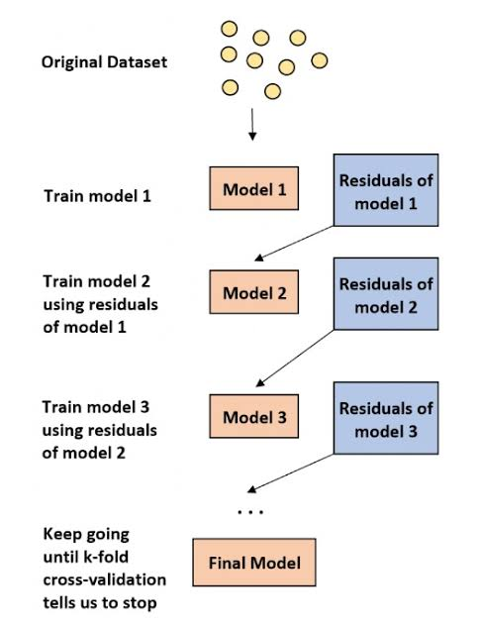
Methodology
Lightgbm:Light Gradient Boosting Machine
Gradient boosting framework based on decision tree.
Various parameter:boosting type,num_leaves,max_depth,learning rate,max_depth,random_state.
It grows leaf by leaf
Library used: Pandas, Numpy, Seaborn, Matplotlib, Scikitlearn, Lightbgm
Tools Required: Jupyter Notebook
https://www.statology.org/boosting-machine-learning/

Slide 15
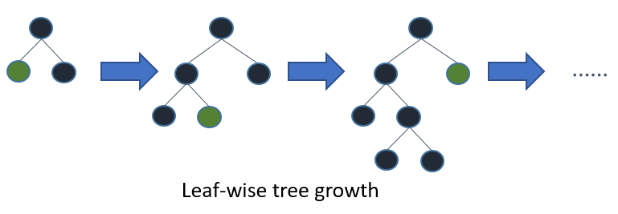
Why Lightgbm?
Less training time
Less memory usage
More accuracy
Capable of handling large datasets
There may be a case of overfitting but can
be avoided by setting max_depth
https://www.techleer.com/articles/489-lightgbm-a-light-gradient-boosting-machine/

Slide 16
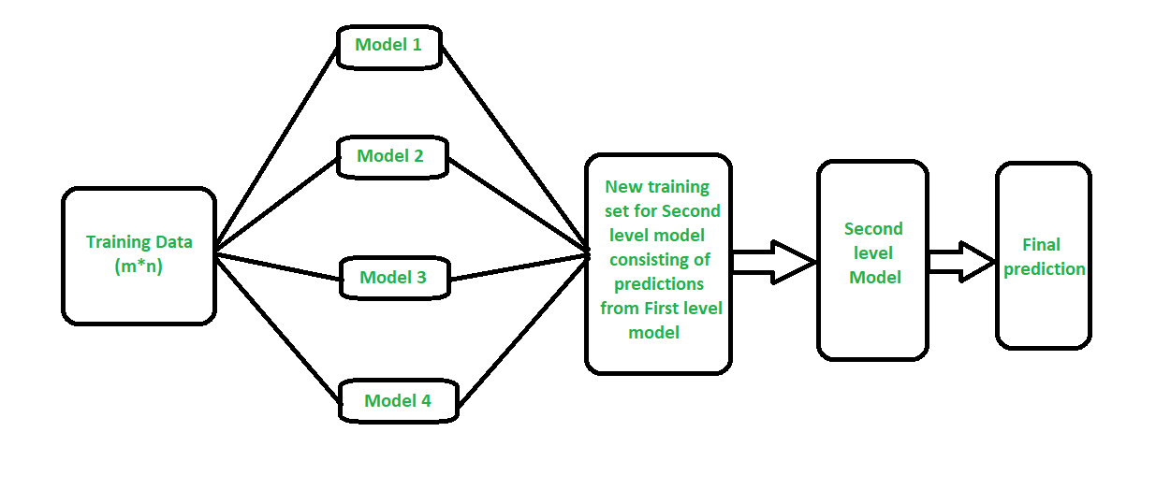
Methodology
Stacked model:
Library used:Pandas,Numpy,seaborn,matplotlib,Scikitlearn,Lightbgm,tensorflow
Tools Required:Jupyter Notebook
https://www.geeksforgeeks.org/stacking-in-machine-learning/

Slide 17
Base Models:
K-Nearest Neighbor
Light Gradient Boosting
Random Forest
Meta model:
Linear Regression

Slide 18
Results
We achieved following accuracy for the given below models:
Linear Regression: 73.20%
Gradient Boosting: 91.87%
Stacked Model: 91.77%

Slide 19
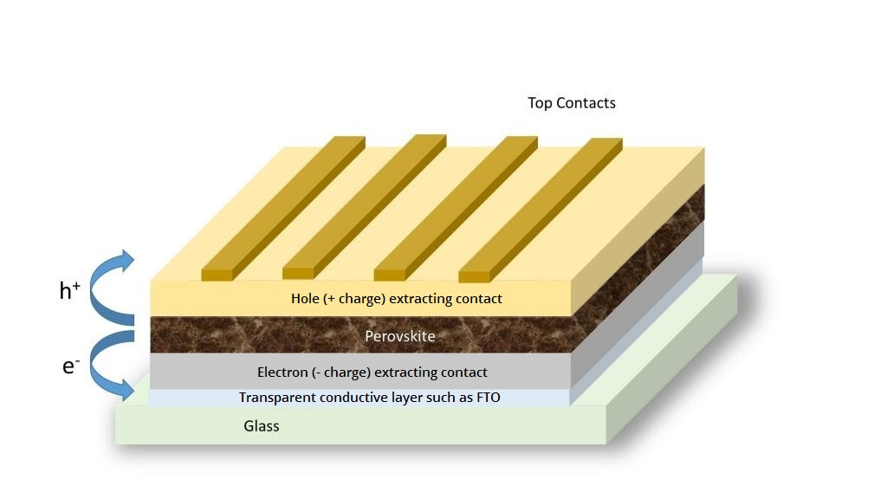
Future Work
We plan on implementing the same models with similar dataset generated from Perovskite material in future. As it is seen that perovskite-Si tandem panel is more efficient and cost friendly than silicone panels
https://www.cei.washington.edu/education/science-of-solar/perovskite-solar-cell/

Slide 20

We need charging points!!! (like petrol pump)
Generation of electricity at charging point
Prediction

Slide 21
References
https://www.techleer.com/articles/489-lightgbm-a-light-gradient-boosting-machine/
https://www.geeksforgeeks.org/stacking-in-machine-learning/
https://www.cei.washington.edu/education/science-of-solar/perovskite-solar-cell/
https://www.geeksforgeeks.org/ml-linear-regression/
https://www.techleer.com/articles/489-lightgbm-a-light-gradient-boosting-machine/
https://www.yellowhaze.in/solar-irradiance/
https://commons.wikimedia.org/wiki/File:Global

